Slide 1

Fyzabad Anglican Secondary School
Form 3 A time of transition
Subject Choice and Career
Information Session For
Students and Parents

Slide 2
Choosing Subjects
What are some of the things that we should consider when choosing subjects for Form Four?

Slide 3
Preference or ability (doing well)
Marks (greatest influence)
Parents or guardians
Factors Influencing Subject Choice
Form/subject teacher
The offerings at school
Career Interests

Slide 4

Subjects in Forms Four and Five
The subjects chosen in Forms four and Five usually form the foundation of the career path that you will choose.

Slide 5
Career, Occupation, Job
A Career is a sequence of occupations and other life roles that expresses a person's commitment to work and reflects a pattern of self-development.
Usually, each person has one life-long career that may include many occupations and jobs.

Slide 6

Examples of Careers:
You can have a career in:
ARTS AND ENTERTAINMENT
EDUCATION,
HEALTH CARE,
CONSTRUCTION etc.

Slide 7
Factors Affecting Career Choice
Self Awareness
Self-awareness is knowledge of your own personal characteristics such as your:
Interests
Values
Abilities
What you need/want in a career.

Slide 8

Why is it important to be Self Aware?
Everyone is unique, with different interests, abilities and skills which contribute to them being the best version of themselves.
Knowing your skills, abilities, strengths and even weaknesses help you to function at your greatest capacity.
When looking at career options, who you are is instrumental in choosing what would best suit you!

Slide 9
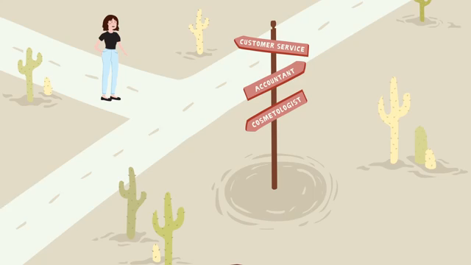

Slide 10

These are things that peek your attention. It’s the feeling of wanting to know or learn about something or someone…
People can be interested in a number of different things at any given point in time. Interests can also change over time.
Interests are those activities you do for fun or enjoy, including what you like to read, the TV shows and movies you like to watch, events you like to attend, and the kind of people you admire and with whom you socialize .

Slide 11

Values are concepts you hold strong to; they help shape who you are.
They are traits or life ideas you consider important or have a high opinion of. E.g. honesty, kindness, loyalty, truthfulness, religion, culture.
Types of Values
Intrinsic - the work itself, the work’s contribution to society.
Extrinsic – favorable conditions that accompany an occupation e.g. working conditions, salary etc.

Slide 12
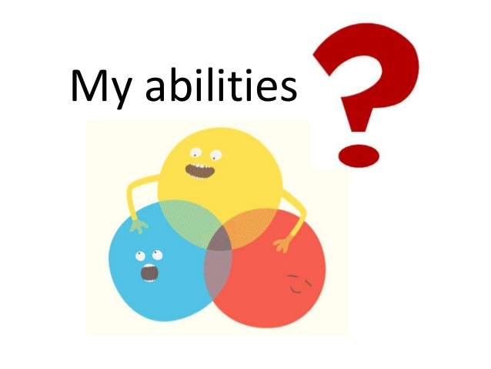
Now think… What do I
do well?
Your abilities are those things you do well.
They include:
    special talents
    skills
    strengths
    weaknesses

Slide 13
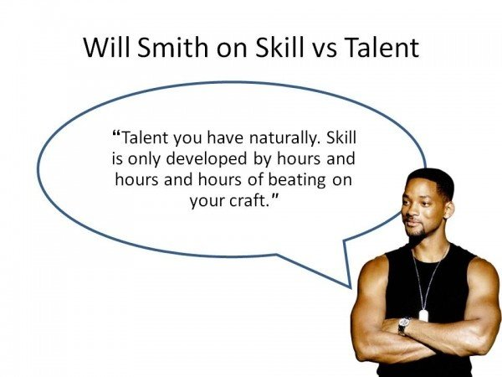
Skills and Talents
While talent is a natural gift and a skill is learnt, talents can also be developed and improved through training and practice.

Slide 14

What do you want/need in a career?
Career needs and wants go beyond your interests and abilities. They are what you need or want in an organization/company.
These would include such things as:
  challenge
  variety
  money
  stability
  responsibility
  recognition
  satisfaction

Slide 15
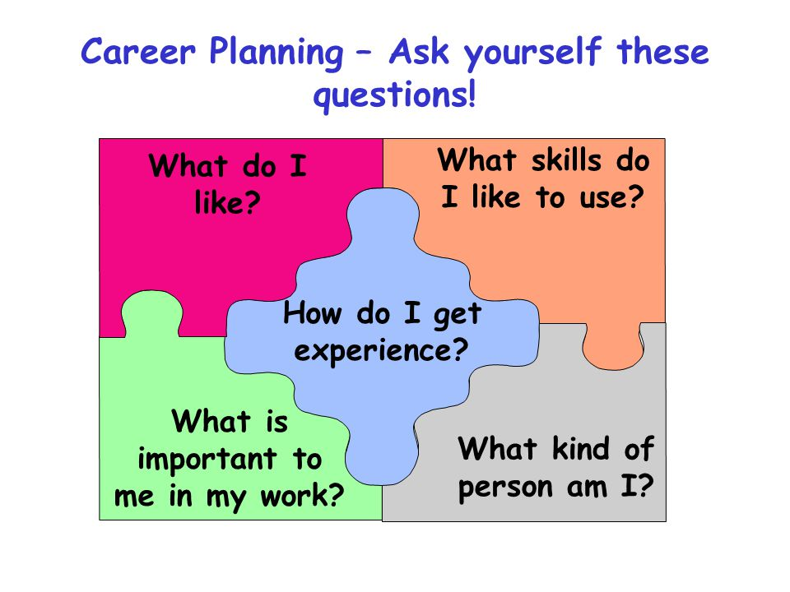

Slide 16
How are CLASSES Grouped?
Humanities
Business
Sciences
Arts

Slide 17

SCIENCE
ENGLISH A
MATHEMATICS
BIOLOGY
CHEMISTRY
PHYSICS
SPANISH
Add Maths/P.E
Geography/French

Slide 18

Business
ENGLISH A
MATHEMATICS
INTERGRATED SCIENCE
P.O.B
P.O.A
Add Maths/ Spanish
Geography/ Economics
Visual Arts/ Social Studies

Slide 19
Humanities
ENGLISH A
MATHEMATICS
INTERGRATED SCIENCE
ENGLISH B
SPANISH
P.O.B/I.T/Social Studies
Geography/ French/Music
History/P.E./ Theatre Arts

Slide 20

Arts
ENGLISH A
MATHEMATICS
INTERGRATED SCIENCE
SOCIAL STUDIES
SPANISH
Visual Arts/ P.O.B/I.T
Music/Geography
Theatre Arts/History/P.E.

Slide 21
SIMILARITIES IN THE CLASS GROUPINGS
BUSINESS
HUMANITIES
ARTS
ENGLISH A
MATHEMATICS
INTERGRATED SCIENCE
P.O.B
P.O.A
Add Maths/ Spanish
Geography/ Economics
Visual Arts/ Social Studies
ENGLISH A
MATHEMATICS
INTERGRATED SCIENCE
ENGLISH B
SPANISH
P.O.B/I.T/Social Studies
Geography/ French/Music
History/P.E./ Theatre Arts
ENGLISH A
MATHEMATICS
INTERGRATED SCIENCE
SOCIAL STUDIES
SPANISH
Visual Arts/ P.O.B/I.T
Music/Geography
Theatre Arts/History/P.E.

Slide 22

Students the Challenge is
Being able to match Subject choices and career choices with:
Your interests,
Your values,
Your Needs,
And your skills and abilities.
This Photo by Unknown Author is licensed under CC BY-SA

Slide 23

What Parents Can Do?
Talk with your child to figure out what you can do to make this important phase a successful transition.
Your support and encouragement is needed.

Slide 24
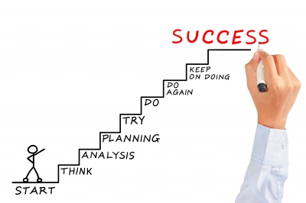
REMEMBER you must Plan for your

Slide 25


